Slide 1
Visual Studio 2017
12 Jun 18 | Start
14 Jun 18 | 10: 22-36
Appendix
Online

Slide 2
Visual Studio 2017
Ch | Date
1 | 00 May 18
2
3
4
5
6
7
8
Professional Visual Studio 2017

Slide 3
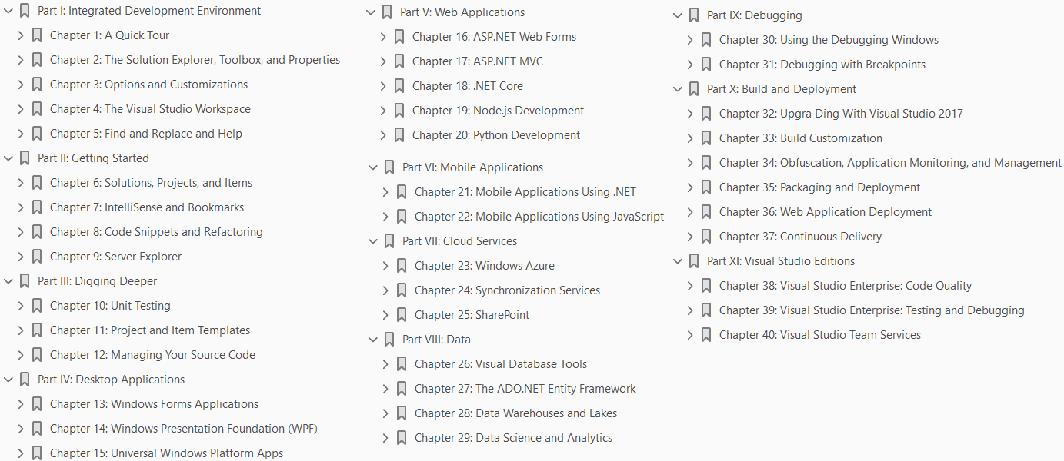

Slide 4
1

Slide 5
Intro

Slide 6
2

Slide 7
Intro

Slide 8
3

Slide 9
Intro

Slide 10
4

Slide 11
Intro

Slide 12
5

Slide 13
Intro

Slide 14
6

Slide 15
Intro

Slide 16
7

Slide 17
Intro

Slide 18
8

Slide 19
Intro

Slide 20
9

Slide 21
Intro

Slide 22
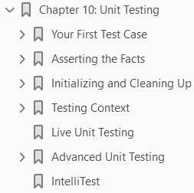
10
Unit Testing

Slide 23
What’s in this chapter?
What’s in this chapter?
Generating a test harness from existing code
Making assertions about the behavior of your code
Executing custom code during test life-cycle events
Creating data-driven tests
Testing private members
Utilizing Live Unit Testing

Slide 24
Wrox.com code downloads
The wrox.com code downloads for this chapter can be found at www.wrox.com by searching for this book’s ISBN number (978-1-119-40458-3).
The code and any related support files are located in their own folder for this chapter.

Slide 25
Intro
Application testing is one of the most important parts of writing software.
Research into the costs of software maintenance have revealed that a software defect can cost up to 100 times more to fix if it makes it to a production environment than if it had been caught during development (from a report by the System Sciences Institute at IBM).
At the same time, a lot of testing involves
Repetitive
dull, and
error-prone work that must be undertaken every time you make a change to your code base
The easiest way to counter this is to produce repeatable automated tests that can be executed by a computer on demand.
This chapter looks at a specific type of automated testing that focuses on individual components, or units, of a system.
Having a suite of automated unit tests gives you the power to verify that your individual components all work as specified even after making radical changes to them.

Slide 26
Intro |
Visual Studio 2017 has a built-in framework for
Authoring
executing, and
reporting on test cases
This chapter focuses on
Creating
Configuring
running, and
managing a suite of unit tests as well as
adding support to drive the tests from a set of data

Slide 27
Your First Test Case
Writing test cases is not easily automated because the test cases must mirror the functionality of the software developed.
In fact, there are solid arguments against automating all but the simplest of unit tests.
However, at several steps in the process, code stubs can be generated by a tool.
To illustrate this, start with a straightforward snippet of code to learn to write test cases that fully exercise the code.
Setting the scene is a Subscription class with a public property called CurrentStatus, which returns the status of the current subscription as an enumeration value: Code 10-1.
As you can see from the code snippet, four code paths need to be tested for the CurrentStatus property.
To test this property, you create a separate SubscriptionTest test class in a new test project, into which you
add a test method that contains the code necessary to instantiate a Subscription object
set the PaidUpTo property, and
check that the CurrentStatus property contains the correct result
Then you keep adding test methods until all the code paths through the CurrentStatus property have been executed and tested.

Slide 28
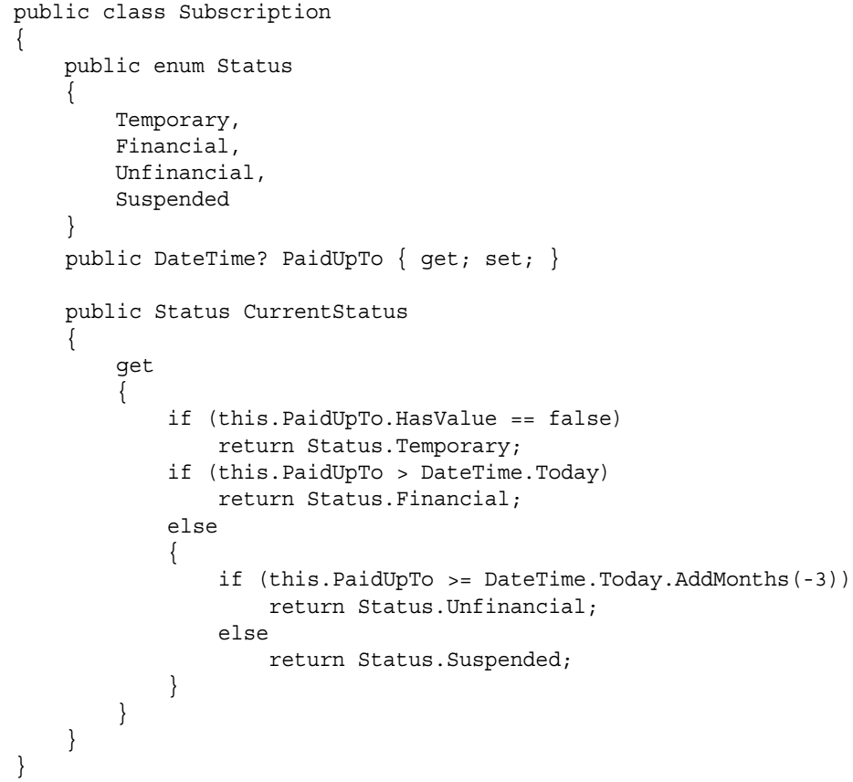
Code 10-1

Slide 29
VS Tool
Visual Studio 2017 includes a tool that can be used to help create unit tests for existing classes.
It creates a test project, along with a number of methods that run your classes through some basic steps.
This is described in the “IntelliTests” section later in this chapter.
However, even with a tool that helps generate unit tests, you still need to know what makes a particular method a unit test.
Visual Studio provides a runtime engine that can
run the test cases
monitor their progress, and
report on any outcome from the tests
Therefore, all you need to do is write the code to test the property in question.
To see the basic template of a test class, make sure that the test project is selected in Solution Explorer and then select Project ➪ Add Unit Test.
This creates a test class and a single test method.
The Unit Test template includes just a basic unit test class containing just a single method: Code 10-2.
For this example, the test class has been changed to SubscriptionTest (as opposed to the default UnitTest1) to indicate the class being tested:

Slide 30
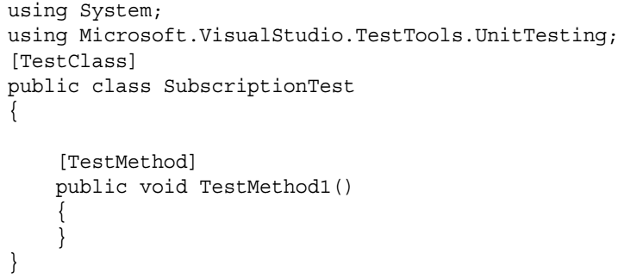
Code 10-2

Slide 31
Techniques – Write Test Code
Although there are a number of techniques that can be used to write your own unit tests, there are two main ideas that you should keep in mind.
One is that, given a large number of unit tests in a project, it can quickly become difficult to manage them.
To address this issue, it is suggested that a naming convention be used.
As you might expect, there are many different conventions that can be used, but a popular one is MethodName_StateUnderTest_ExpectedBehavior.
This simple naming convention ensures that test cases can easily be found and identified.
A second (and complementary) idea is to approach each test using an Arrange/Act/Assert paradigm.
Start by setting up and initializing the values used in the test (the Arrange portion).
Then execute the method being tested (Act).
Finally, determine the outcome of the test (Assert).
If you follow this approach, you end up with unit tests that look like the following: Code 10-3.
Before going any further, run this test case to see what happens by right-clicking in the code window and selecting Run Tests.
The result is the Test Explorer, as shown in Figure 10-1.

Slide 32
Techniques – Write Test Code |
Figure 10-1 shows a test case that returns an inconclusive result.
The warning icon (the triangle with the exclamation) indicates that the test was skipped.
In the details for the test result (on the right side of Figure 10-1), there is a message that indicates that Assert.Inconclusive failed.
Essentially, an inconclusive assertion indicates either that
a test is not complete or
that the results should not be relied upon
because changes may have been made that would make this test invalid
The results show basic information about
the test
the result, and
other useful environmental information such as the
computer name and
test execution duration

Slide 33
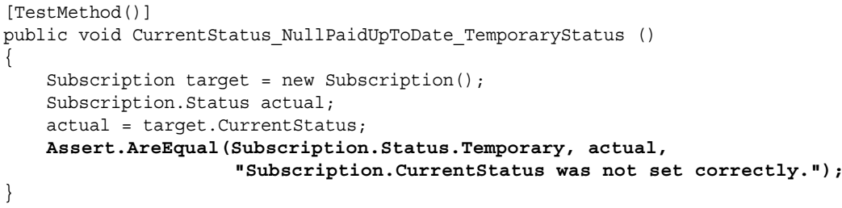
Techniques – Write Test Code ||
In creating this unit test, the Assert.Inconclusive statement was inserted by hand.
To complete the unit test, it is necessary to actually perform the appropriate analysis of the results to ensure that the test passed.
This is accomplished by replacing the Assert.Inconclusive statement with Assert.AreEqual, as shown in the following code:

Slide 34
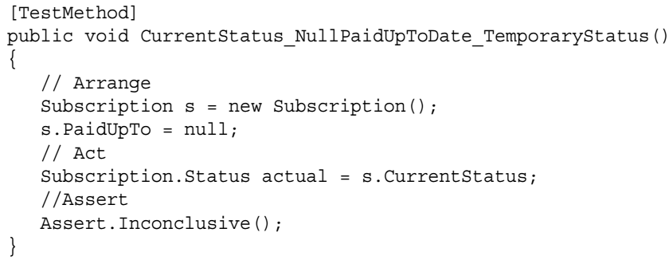
Code 10-3

Slide 35
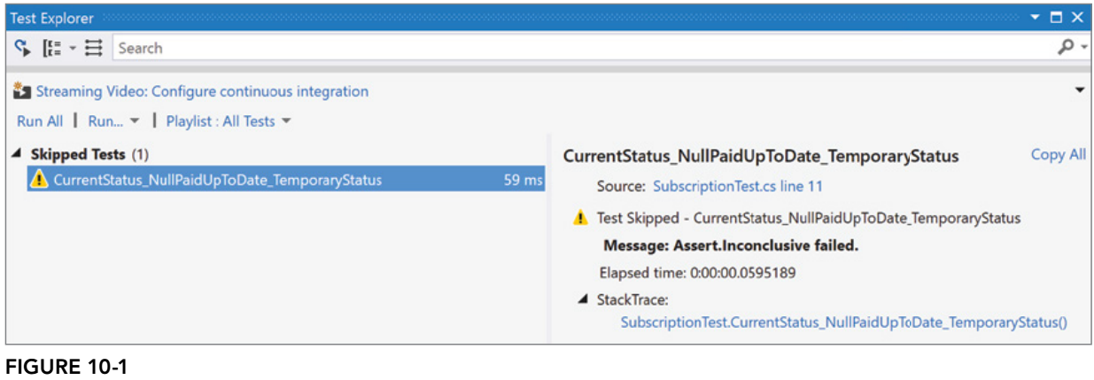
Figure 10-1

Slide 36
NOTE
The context menu is just one way to
select and
run a test case
There is a Test menu that includes a Run submenu that allows for the execution of
all or
selected tests
Or you can open the Test Explorer window directly and run all or selected tests using the links (refer to Figure 10-1).
In addition to each of these methods, you can also
set breakpoints in your code and
run test cases in the debugger by selecting
one of the Debug Tests options from the main toolbar

Slide 37
Test Categories
Although it is not apparent from the work you have done to this point, the completed tests are grouped into one of three categories:
Failed Tests
Passed Tests, and
Not Run Tests
It is possible to
run all the tests
only the tests from a specific category
repeat the last test run, or
just the tests that you select
The Run link at the top of the Test Explorer contains a drop-down where you can select the category of tests to run.
To select individual tests to run, click the desired tests (using the standard Ctrl+click or Shift+Ctrl+click to add tests after the first one), and then right-click and choose Run Selected Tests.
After you fix the code that caused the tests to fail, click the Run All button to rerun these test cases and produce a successful result, as shown in Figure 10-2.

Slide 38
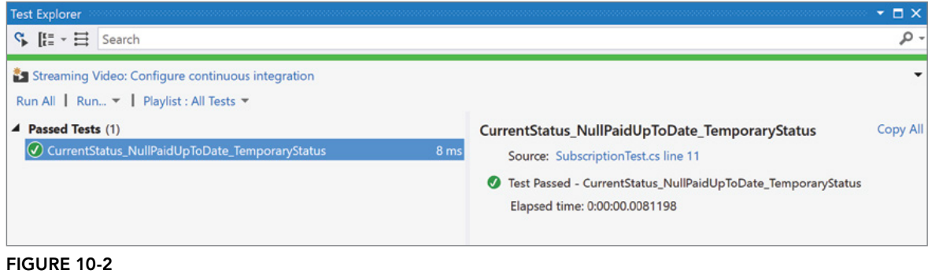
Figure 10-2

Slide 39
NOTE
There is one thing to be aware of regarding unit tests.
Put simply, the default behavior for a unit test method is to “pass.”
And the way that you change this behavior is by
adding Assert statements to the method,
the idea being that if one of the Assert statements fail
the unit test is considered to have “failed.”
However, when you manually create a brand new unit test, there are no assertions present, which means that the unit test doesn’t start out “failing.”
To address this, an Assert.Inconclusive is automatically placed into unit tests when they are created.
For any test, executing an Assert.Inconclusive means that the test will always fail.
When you remove the Assert.Inconclusive statement, you are indicating that the test case is complete.

Slide 40
Further Test Cases
In this example, we have exercised only one code path, and you should add further test cases that fully exercise the other categories.
While you could add additional assertions to the one test method that you’ve created, this is not considered to be the best practice for writing unit tests.
The general approach is to have each test method test one and only one thing.
This means that (ideally) there is only one Assert in the method.
The reason for this is that more granular tests mean that if the test fails, the cause is usually more readily apparent.
Also, keep in mind that the method does not continue executing past the first failed Assert.
Multiple assertions in a method just make it a little more difficult to determine the cause of the failure.
That having been said, it is common to have two or three assertions, and there is a parameter that can be passed into the Assert statement for the message that is displayed if the test fails.

Slide 41
Identifying Tests Using Attributes
Before going any further with this scenario, take a step back to consider how testing is carried out within Visual Studio 2017. All test cases must exist within test classes that reside in a test project. But what actually distinguishes a method, class, or project as containing test cases? Starting with the test project, if you look at the underlying XML project file, you can see that there is virtually no difference between a test project file and a normal class library project file. In fact, the only difference appears to be the project type: When this project is built, it simply outputs a standard .NET class library assembly. The key difference is that Visual Studio recognizes this as a test project and automatically analyzes it for any test cases to populate the various test windows. Classes and methods used in the testing process are marked with an appropriate attribute. The attributes are used by the testing engine to enumerate all the test cases within a particular assembly.
(Page 225).

Slide 42
TestClass
All test cases must reside within a test class that is appropriately marked with the TestClass attribute. Although it may appear that there is no reason for this attribute other than to align test cases with the class and member that they are testing, you later see some benefits associated with grouping test cases using a test class. For testing the Subscription class, a test class called SubscriptionTest was created and marked with the TestClass attribute. Because Visual Studio uses attributes to locate classes that contain test cases, the name of this class is irrelevant. However, adopting a naming convention, such as adding the Test suffix to the class being tested, makes it easier to manage a large number of test cases.
(Page 225).

Slide 43
TestMethod
Individual test cases are marked with the TestMethod attribute, which is used by Visual Studio to enumerate the list of tests that can be executed. The CurrentStatus_NullPaidUpToDate_ TemporaryStatus method in the SubscriptionTest class is marked with the TestMethod attribute. Again, the actual name of this method is irrelevant, because Visual Studio uses only the attributes to find tests. However, the method name is used in the various test windows when the test cases are listed, so it is useful for test methods to have meaningful names. This is especially true when reviewing test results.
(Page 225).

Slide 44
Additional Test Attributes
As you have seen, the unit-testing subsystem within Visual Studio uses attributes to identify test cases. A number of additional properties can be set to provide further information about a test case. This information is then accessible either via the Properties window associated with a test case or within the other test windows. This section goes through the descriptive attributes that can be applied to a test method.
(Page 226).

Slide 45
Description
Because test cases are listed by the test method name, a number of tests may have similar names, or names that are not descriptive enough to indicate what functionality they test. The Description attribute, which takes a String as its sole argument, can be applied to a test method to provide additional information about a test case.
(Page 226).

Slide 46
Owner
The Owner attribute, which also takes a String argument, is useful for indicating who owns, wrote, or is currently working on a particular test case.
(Page 226).

Slide 47
Priority
The Priority attribute, which takes an Integer argument, can be applied to a test case to indicate the relative importance of a test case. Though the testing framework does not use this attribute, it is useful for prioritizing test cases when you are determining the order in which failing, or incomplete, test cases are resolved.
(Page 226).

Slide 48
TestCategories
The TestCategory attribute accepts a single String identifying one user-defined category for the test. Like the Priority attribute, the TestCategory attribute is essentially ignored by Visual Studio but is useful for sorting and grouping related items together. A test case may belong to many categories but must have a separate attribute for each one.
(Page 226).

Slide 49
WorkItems
The WorkItem attribute can be used to link a test case to one or more work items in a work-item tracking system such as Team Foundation Server. If you apply one or more WorkItem attributes to a test case, you can review the test case when making changes to existing functionality. You can read more about Team Foundation Server in Chapter 12, “Managing Your Source Code.”
(Page 226).

Slide 50
Ignore
You can temporarily prevent a test method from running by applying the Ignore attribute to it. Test methods with the Ignore attribute will not be run and will not show up in the results list of a test run.
(Page 226).

Slide 51
Timeout
A test case can fail for any number of reasons. A performance test, for example, might require a particular functionality to complete within a specified time frame. Instead of the tester writing complex multithreading tests that stop the test case when a particular timeout has been reached, you can apply the Timeout attribute to a test case with a timeout value in milliseconds, as shown in the following code. This ensures that the test case fails if that timeout is reached.
(Page 227).

Slide 52
Unit Tests and Code Lens
Unit tests provide some additional advantage beyond the Code Lens functionality that was described in Chapter 4, “The Visual Studio Workspace.” Figure 10-3 illustrates the code for a unit test as it appears in the code editor when the test class is first opened. Immediately to the left of the References link is a little blue diamond-shaped icon. The tool tip for the icon indicates that the test has not been run. In actuality, it means that the test hasn’t been run for this session. There is nothing that persists between executions of Visual Studio to indicate that the test might have been run in the past. After the test has been executed, the icon changes. What it changes to depends on the outcome of the test. Figure 10-4 shows the icon when a test has been skipped (such as when an Assert.Inconclusive is executed). The icon is not just a visual representation of the test’s state. When you click on the icon you see additional details about the test result, as shown in Figure 10-5. This is similar to the information displayed in the Test Explorer (refer to Figure 10-1).
(Page 228).

Slide 53
Asserting the Facts
So far, this chapter has examined the structure of the test environment and how test cases are nested within test classes in a test project. What remains is to look at the body of the test case and review how test cases either pass or fail. (When a test case is generated, you saw that an Assert .Inconclusive statement is added to the end of the test to indicate that it is incomplete.) The idea behind unit testing is that you start with the system, component, or object in a known state, and then run a method, modify a property, or trigger an event. The testing phase comes at the end, when you need to validate that the system, component, or object is in the correct state. Alternatively, you may need to validate that the correct output was returned from a method or property. You do this by attempting to assert a particular condition. If this condition is not true, the testing system reports this result and ends the test case. A condition is asserted, not surprisingly, via the Assert class. There is also a StringAssert class and a CollectionAssert class, which provide additional assertions for dealing with String objects and collections of objects, respectively.
(Page 229).

Slide 54
The Assert Class
The Assert class in the UnitTesting namespace, not to be confused with the
Debug.Assert or
Trace.Assert method in the System.Diagnostics namespace, is the primary class used to make assertions about a test case. The basic assertion has the following format:
(Page 229).

Slide 55
The StringAssert Class
The StringAssert class does not provide any additional functionality that cannot be achieved with one or more assertions via the Assert class. However, it not only simplifies the test case code by making it clear that String assertions are being made; it also reduces the mundane tasks associated with testing for particular conditions. The additional assertions are as follows: ➤ Contains: Tests whether a String contains another String ➤ DoesNotMatch: Tests whether a String does not match a regular expression ➤ EndsWith: Tests whether a String ends with a particular String ➤ Matches: Tests whether a String matches a regular expression ➤ StartsWith: Tests whether a String starts with a particular String
(Page 230).

Slide 56
The CollectionAssert Class
Similar to the StringAssert class, CollectionAssert is a helper class used to make assertions about a collection of items. Some of the assertions are as follows: ➤ AllItemsAreNotNull: Tests that none of the items in a collection is a null reference ➤ AllItemsAreUnique: Tests that no duplicate items exist in a collection ➤ Contains: Tests whether a collection contains a particular object ➤ IsSubsetOf: Tests whether a collection is a subset of another collection
(Page 230).

Slide 57
The ExpectedException Attribute
Sometimes test cases have to execute paths of code that can cause exceptions to be raised. Though exception coding should be avoided, conditions exist where this might be appropriate. Instead of writing a test case that includes a Try-Catch block with an appropriate assertion to test that an exception was raised, you can mark the test case with an ExpectedException attribute. For example, change the CurrentStatus property to throw an exception if the PaidUp date is prior to the date the subscription opened, which in this case is a constant:
(Page 231).

Slide 58
Initializing and cleaning up
There are occasions when you have to write a lot of setup code, code that is executed whenever you run a test case. For example, when a unit test uses a database, that database should be returned to its initial state after each test to ensure that the test cases are completely repeatable. This is also true for unit tests that modify other resources, such as the filesystem. Visual Studio provides support for writing methods that can be used to initialize and clean up around test cases. (Again, attributes are used to mark the appropriate methods that should be used to initialize and clean up the test cases.) The attributes for initializing and cleaning up around test cases are broken down into three levels: those that apply to individual tests, those that apply to an entire test class, and those that apply to an entire test project.
(Page 232).

Slide 59
TestInitialize and TestCleanup
As their names suggest, the TestInitialize and TestCleanup attributes indicate methods that should be run before and after each test case within a particular test class. These methods are useful for allocating and subsequently freeing any resources needed by all test cases in the test class.
(Page 233).

Slide 60
ClassInitialize and ClassCleanup
Sometimes, instead of setting up and cleaning up after each test, it can be easier to ensure that the environment is in the correct state at the beginning and end of running an entire test class. Test classes are a useful mechanism for grouping test cases; this is where you put that knowledge to use. Test cases can be grouped into test classes that contain one method marked with the ClassInitialize attribute and another marked with the ClassCleanup attribute. These methods must both be marked as static, and the one marked with ClassInitialize must take exactly one parameter that is of type UnitTesting.TestContext.
(Page 233).

Slide 61
AssemblyInitialize and AssemblyCleanup
The final level of initialization and cleanup attributes is at the assembly, or project, level. Methods intended to initialize the environment before running an entire test project, and cleaning up after, can be marked with the AssemblyInitialize and AssemblyCleanup attributes, respectively. Because these methods apply to any test case within the test project, only a single method can be marked with each of these attributes. Like the class-level equivalents, these methods must both be static, and the one marked with AssemblyInitialize must take a parameter of type UnitTesting.TestContext. For both the assembly-level and class-level attributes, it is important to remember that even if only one test case is run, the methods marked with these attributes will also be run.
(Page 233).

Slide 62
Testing context
When you write test cases, the testing engine can assist you in a number of ways, including by managing sets of data so that you can run a test case with a range of data and enabling you to output additional information for the test case to aid in debugging. This functionality is available through the TestContext object generated within a test class and passed into the AssemblyInitialize and
(Page 233).

Slide 63
Data
The CurrentStatus_NullPaidUpToDate_TemporaryStatus method written in the first section of this chapter tested only a single path through the CurrentStatus property. To fully test this property, you could have written additional methods, each with its own setup and assertions. However, this process is fairly repetitive and would need to be updated if you ever changed the structure of the CurrentStatus property. An alternative is to provide a DataSource for the CurrentStatus_ NullPaidUpToDate_TemporaryStatus method whereby each row of data tests a different path through the property. To add appropriate data to this method, use the following process: 1. Create a local database file (an .MDF file) and database table to store the various test data. (The details on how to do this can be found in Chapter 26, “Visual Database Tools.”) In this case, create a database called LoadTest with a table called Subscription_CurrentStatus. The table has an Identity bigint column called Id, a nullable datetime column called PaidUp, and an nvarchar(20) column called Status. 2. Add appropriate data values to the table to cover all paths through the code. Test values for the CurrentStatus property are shown in Figure 10-9.
(Page 234).

Slide 64
Writing Test Output
Writing unit tests is all about automating the process of testing an application. Because of this, these test cases can be executed as part of a build process, perhaps even on a remote computer. This means that the normal output windows, such as the console, are not a suitable place for outputting test-related information. Clearly, you also don’t want test-related information interspersed throughout the debugging or trace information being generated by the application. For this reason, there is a separate channel for writing test-related information so that it can be viewed alongside the test results. The TestContext object exposes a WriteLine method that takes a String and a series of String .Format arguments that can be used to output information to the results for a particular test. For example, adding the following line to the CurrentStatusDataTest method generates additional information with the test results:
(Page 237).

Slide 65
Live Unit Testing
Visual Studio 2017 introduces a new feature related to unit testing. Called Live Unit Testing, it allows the developer to track the impact that changes to the code is having on the success or failure of unit tests in real time. It does this within the context of the code editor. This takes the idea of catching test failures early to a new level.
(Page 238).

Slide 66
Advanced Unit Testing
Up until this point, you have seen how to write and execute unit tests. This section examines how you can add custom properties to a test case, and how you can use the same framework to test private methods and properties.
(Page 239).

Slide 67
Custom Properties
The testing framework provides a number of test attributes that you can apply to a method to record additional information about a test case. This information can be edited via the Properties window
(Page 239).

Slide 68
Testing Private Members
One of the selling points of unit testing is that it is particularly effective for testing the internals of your class to ensure that they function correctly. The assumption here is that if each of your components works in isolation, there is a better chance that they will work together correctly; and in fact, you can use unit testing to test classes working together. However, you might wonder how well the unit-testing framework handles testing private methods. One of the features of the .NET Framework is the capability to reflect over any type that has been loaded into memory and to execute any member regardless of its accessibility. This functionality does come at a performance cost because the reflection calls obviously include an additional level
(Page 240).

Slide 69
Intellitest
Visual Studio 2017 includes a testing feature called IntelliTest. It is an outgrowth of the Pex project that has been active in Microsoft Research for a number of years. Although it can be used in a number of different situations, its strength is in filling in “holes” in unit test coverage — holes such as when legacy code has no unit tests at all, or when the unit tests that are already written don’t cover the edge cases for the class under test. To provide this functionality, IntelliTest performs an analysis of the method (or methods) that you indicate should be tested. For each method, the different paths that can be taken through the code are identified. Then a unit test is generated for each path by setting precise values for any parameters required to exercise the path. The goal is to create a set of unit tests that cover the code as completely as possible. Create a set of IntelliTests starts by right-clicking on the class to be tested and selecting Run IntelliTest from the context menu. This examines the code in the class, generates the appropriate unit tests, and runs them. To get a sense of what the generated tests look like, consider the following method, which is added to the Subscription class described earlier in the chapter.
(Page 242).

